Slide 1





INFORMATION
RETRIEVAL
USING
AUDIO
FILE
AUDIO GERNE
CLASSIFICATION
TEAM 4
INFORMATION
RETRIVAL
AND INTELLIGENT
WEB
ALGORITHMS
FOR

Slide 2







PROBLEM
STATEMENT
THE MUSIC
INDUSTRY FACES A CHALLENGE IN EFFICIENTLY
CATEGORIZING AND DISCOVERING MUSIC GENRES DUE TO THE OVERWHELMING VOLUME AND DIVERSITY OF AUDIO CONTENT. MANUALLY ASSIGNING GENRES TO VAST MUSIC LIBRARIES IS TIME-CONSUMING AND SUBJECTIVE.

Slide 3









SOLUTION
AUTOMATED
MUSIC
GENRE
PREDICTION
AN
UTILIZING
ADVANCED
MACHINE
SYSTEM
LEARNING
ALGORITHMS
AND
FEATURE
THIS
SYSTEM
AIMS
TO
ENHANCE
EXTRACTION.
ACCURACY,
AND
USER
EXPERIENCE
EFFICIENCY,
STREAMLINING
GENRE
CATEGORIZATION,
BY
REAL-TIME
PREDICTIONS,
AND
PROVIDING
TO
THE
EXPANDING
MUSIC
ADAPTING
LANDSCAPE.

Slide 4


Topics Addressed
EFFICIENTLY CATEGORIZING AND DISCOVERING MUSIC GENRES
AUTOMATED SYSTEM FOR ACCURATE MUSIC GENRE PREDICTION

Slide 5










Literature
Review
NUMEROUS STUDIES HAVE EXPLORED THE USE OF SPECTRAL FEATURES FOR MUSIC GENRE CLASSIFICATION TASKS. RESEARCHERS HAVE INVESTIGATED VARIOUS FEATURE EXTRACTION TECHNIQUES, INCLUDING SPECTRAL CENTROID, SPECTRAL FLUX, AND SPECTRAL ROLLOFF, TO CAPTURE DIFFERENT ASPECTS OF THE FREQUENCY CONTENT IN MUSIC RECORDINGS. MACHINE LEARNING ALGORITHMS SUCH AS SUPPORT VECTOR MACHINES (SVM), RANDOM FORESTS, AND CONVOLUTIONAL NEURAL NETWORKS (CNNS) HAVE BEEN WIDELY EMPLOYED FOR CLASSIFICATION TASKS DUE TO THEIR ABILITY TO LEARN COMPLEX PATTERNS FROM AUDIO FEATURES. EXISTING LITERATURE EMPHASIZES THE IMPORTANCE OF FEATURE SELECTION AND MODEL OPTIMIZATION IN ACHIEVING ACCURATE AND ROBUST MUSIC GENRE CLASSIFICATION PERFORMANCE.

Slide 6



Methodologies
DATA COLLECTION AND PREPROCESSING: AUDIO
FEATURES
ARE COLLECTED AND
PREPROCESSED, INCLUDING HANDLING MISSING VALUES,
ENCODING
CATEGORICAL
VARIABLES, AND SPLITTING THE DATASET.
FEATURE EXTRACTION: AUDIO FEATURES LIKE
CHROMA FEATURES CENTROID ARE EXTRACTED USING LIBROSA, AND SPECTROGRAM
AND SPECTRAL ANALYSIS IS
CONDUCTED FOR FREQUENCY VISUALIZATION.
MODEL TRAINING: TWO MODELS ARE TRAINED - XGBOOST CLASSIFIER WITH HYPERPARAMETER TUNING AND A DEEP NEURAL NETWORK WITH DENSE LAYERS AND RELU ACTIVATION.
MODEL EVALUATION: TRAINED MODELS ARE EVALUATED USING METRICS LIKE
MATRICES FOR
ACCURACY, PRECISION, RECALL, AND F1-SCORE, WITH CONFUSION
PERFORMANCE VISUALIZATION.
ANALYSIS AND VISUALIZATION: SPECTROGRAM ANALYSIS AND FEATURE VISUALIZATION PROVIDE INSIGHTS INTO MUSIC CHARACTERISTICS, WHILE CORRELATION ANALYSIS IDENTIFIES FEATURE RELATIONSHIPS.

Slide 7


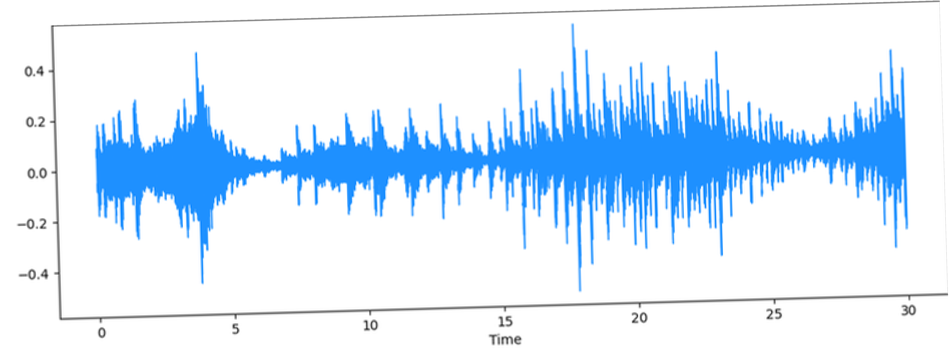


librosa.display.waveshow()

Slide 8

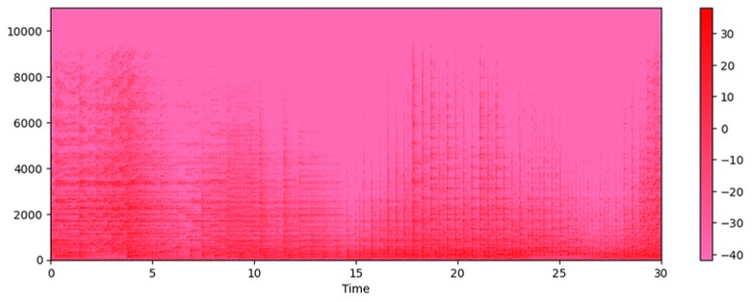
Spectrogram

Slide 9

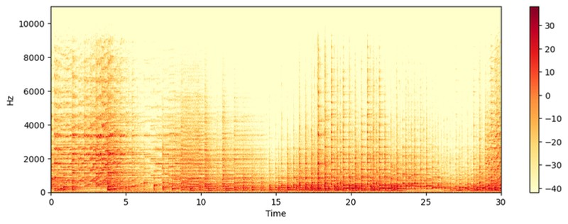


spectrogram of the input
audio signal

Slide 10

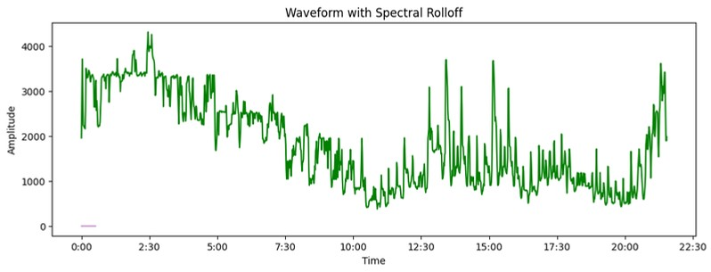


spectral roll off

Slide 11

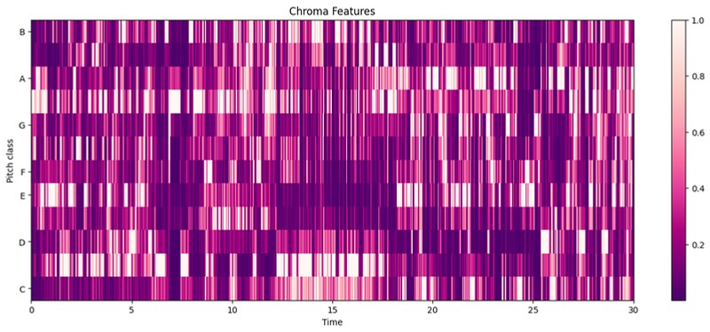
Chroma Features

Slide 12
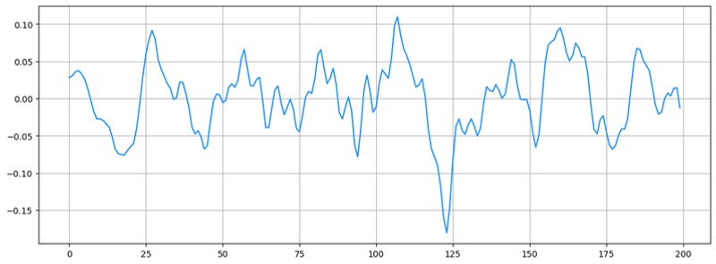
inspecting the signal's
amplitude variation

Slide 13

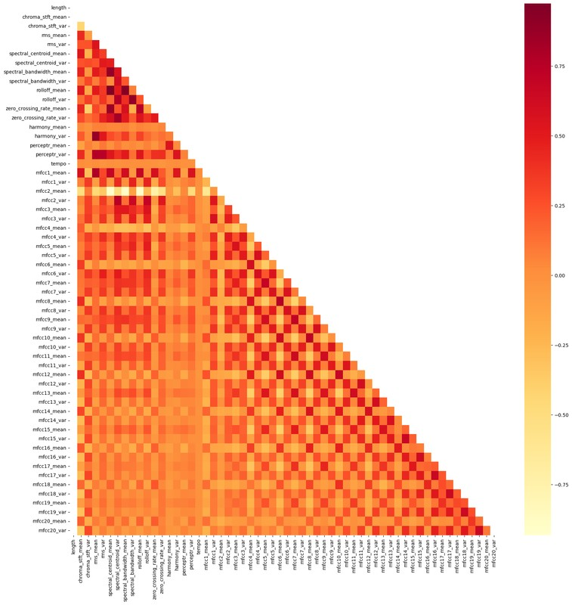
spectrogram of the input audio
signal

Slide 14

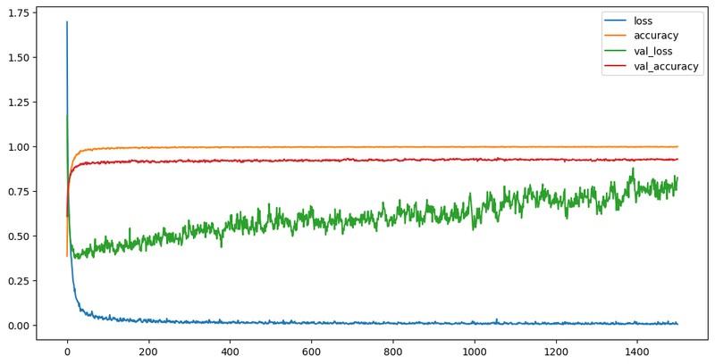
loss & accuracy curves for
training & validation

Slide 15
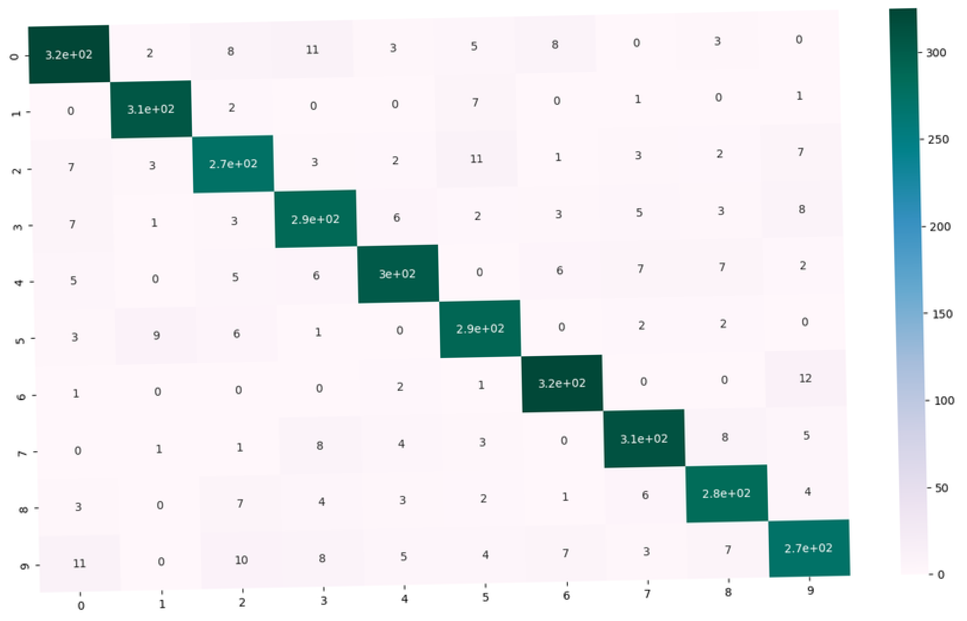


Confusion Matrix

Slide 16

References
Reference paper:
Xin Cai , Hongjuan Zhang, Music genre classification based on auditory image, spectral and acoustic features(2022) Database: https://drive.google.com/drive/folders/157BWyYbFUkGF973W m_abekKU5jvQbxtc

Slide 17




And that's a wrap.
THANK
YOU

